Slide 1
Soils and Foundations 63 (2023) 101332 https://doi.org/10.1016/j.sandf.2023.101332
Addressing the challenges of homogeneity, quality control and waste handling in soil bio-cementation: A large-scale experiment
Ray Harran, Dimitrios Terzis, Lyesse Laloui
[Outline]
Challenges of achieving homogeneity, quality control, waste handling in large-scale soil bio-cementation.
Against limitations of laboratory-scale experiments in replicating large-scale.
Enhancing of Microbially Induced Calcium Carbonate Precipitation (MICP) for ground improvement.
[Methods]
Draining bottom boundary hydrolysis within 1000 L bioreactor.
Hydrolyzed solutions → tank filled with 0-4 mm sand through system of injection tubes.
Monitoring through multilevel spatial and temporal quality control system.
[Results]
Reaction efficiencies exceeded 80%, at injection inlet 75 kPa.
Areas with higher injection pressures exhibited better resistance near the corresponding injection tubes.
Dynamic penetrometer → improved homogeneity.
Ex-situ bio-cementation achieved similar precipitation efficiencies and mechanical improvements.
⸫ bio-cementation, proved, actual liquefaction resistance.

Slide 2
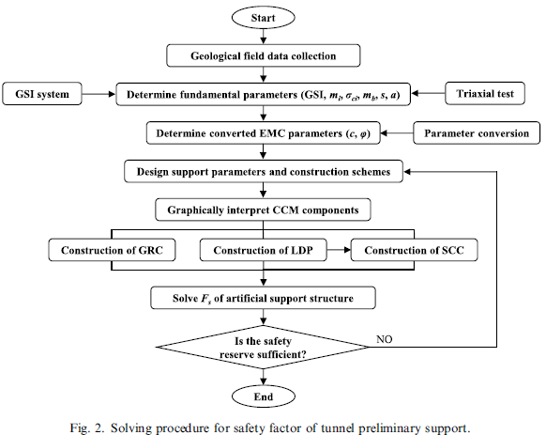
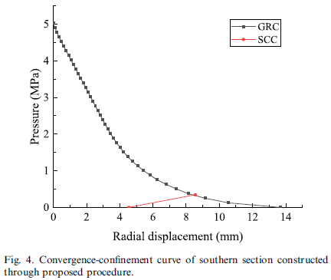
Soils and Foundations 63 (2023) 101356 https://doi.org/10.1016/j.sandf.2023.101356
A quantitative analysis procedure for solving safety factor of tunnel preliminary support considering the equivalence between Hoek–Brown and Mohr–Coulomb criteria Yangyang Liu, Yanbing Fang, Ya Sud, Peng Zhang, Yonghua Su
Outline
Developing a quantitative analysis procedure to determine the F_{S} of tunnel support
→ Equivalence between Hoek-Brown (HB) and Mohr-Coulomb (MC) criteria.
{empirical design limitation}↔{providing stress distribution & support performance}
Integrate empirical methods & safety factor.
Methods
Analyze tunnel stability: Numerical procedure of convergence-confinement method (CCM)
→ By conversion of HB parameters to equivalent MC parameters
Unified numerical model to calculate F_{S} for different tunnel conditions
Results
Max radial convergence and plastic zone area were lower for the equivalent Mohr-Coulomb criterion (TBEMCC): 34.54% compared to the Hoek-Brown criterion (TBHBC), with reductions of 34.54% and 37.29%, respectively.
F_{S} calculated using TBEMCC was also lower, indicating a more conservative estimate.
TBEMCC criterion tends to underestimate the F_{S}, leading to a conservative design.
Proposed method provides a reliable tool for tunnel stability analysis and design optimization.

Slide 3
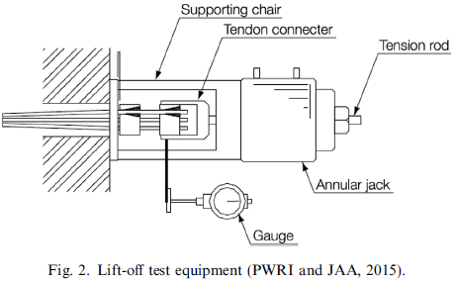
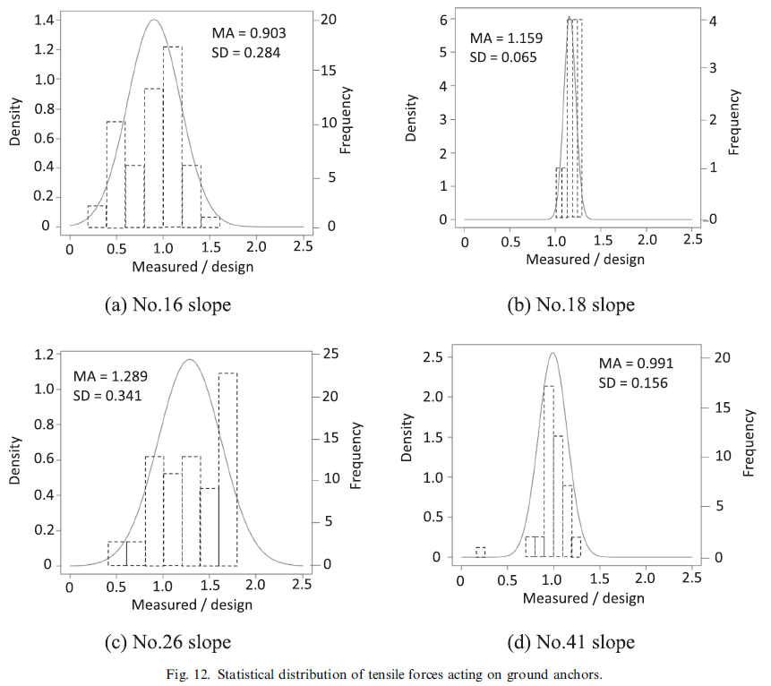
Soils and Foundations 63 (2023) 101353 https://doi.org/10.1016/j.sandf.2023.101353
Assessment of ground-anchored slope stability based on variation in residual tensile forces
Takashi Hara, Naoki Tatta, Atsushi Yashima
[outline]
Many mountain road → many anchor improved
Ground anchored slopes stability change → maintenance [important]
Previous studies focus on ground anchors
This paper: focus on variation in tensile forces acting on ground anchors.
[Methods]
1. Lift-off tests for 45 ground-anchored slopes
2. Probabilistic approach, with simple circular slip analysis
[Results]
- MA + SD from lift-off tests, is an effective parameter for identifying dangerous slopes
- A probabilistic approach using a simple circular slip analysis can reflect slope risk

Slide 4
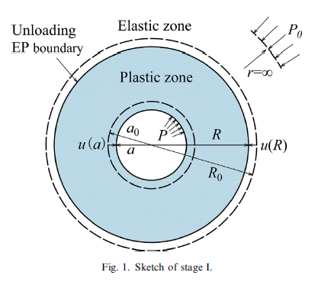
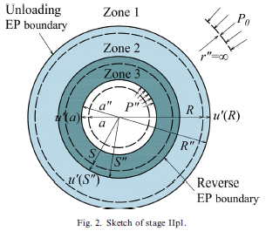
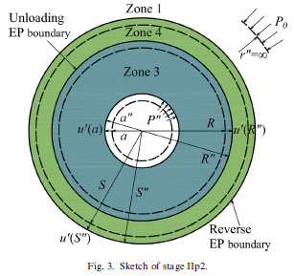
Soils and Foundations 63 (2023) 101339 https://doi.org/10.1016/j.sandf.2023.101339
Cavity reverse expansion considering elastoplastic unloading and application in cast-in-situ bored piles
Chunfeng Zhao, Jiaqi Zhang, Cheng Zhao, Yue Wub, Youbao Wang
[Outline]
Cast-in-situ bored piles disturb the soil, unlike precast-driven piles.
→Accurate model to predict soil response is essential.
Existing theories focus on single-process cavity expansion/contraction
→ not accurately describe the 𝜎 and u
Reverse expansion requires unified model to describe whole-cycle soil response.
[Method]
Develops a unified semi-analytical solution for cylindrical and spherical cavity reverse expansion after unloading in drained soil.
Use Mohr-Coulomb model and logarithmic strain definition to describe reverse plastic.
Parametric analysis is conducted to study 𝜎 and u evolution around the cavity
[Result]
Cavity cannot re-expand even if the cavity pressure reloads to the initial.
Increasing the internal friction angle, cohesion, and Young's modulus positively affects radius recovery, while the dilatancy angle has a negative effect.
For cast-in-situ bored piles, model predicts total radial displacement of soil around the pile dominated by contraction displacement, which correlates positively with depth and negatively with horizontal distance.

Slide 5
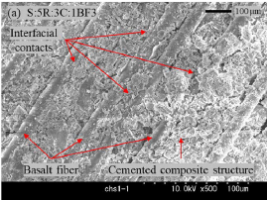
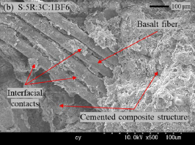
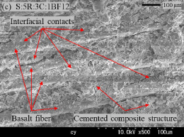
Soils and Foundations 63 (2023) 101351 https://doi.org/10.1016/j.sandf.2023.101351
Correlation between one-dimensional consolidation coefficients and different basalt fiber lengths and RHA-cement contents in fiber-reinforced stabilized expansive soils Alex Otieno Owino, Zakaria Hossain
[Outline]
Traditional soil stabilization methods using cement and lime environmentally damaging
→ Rice husk ash (RHA) and basalt fibers
Correlation between c_{v} and the properties of fiber-reinforced stabilized soils can improve the design and performance of engineering structures built on these problematic soils .
[Method]
A series of oedometer tests
- expansive soils reinforced with basalt fibers and stabilized with RHA and nominal dosages of cement
- Quantified correlation between c_{v}, m_{v}, k with basalt fiber lengths/RHA-cement contents
- Scanning electron microscopy (SEM) was utilized to examine the structural modifications within the soil specimens after 1D consolidation .
[Result]
Specimens with 5% RHA and 3% cement showed lowest 1D c_{v}, with a significant reduction at high-stress states compared to the control specimen.
m_{v} and k decreased with increased compaction, especially in the basalt fiber-reinforced stabilized soil composites.
Best material combination for reinforcing expansive soils was found to be 12-mm basalt fibers, 5% RHA, and 3% cement.

Slide 6
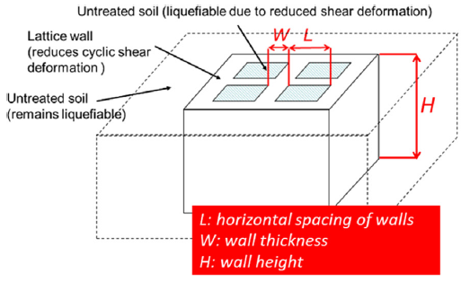
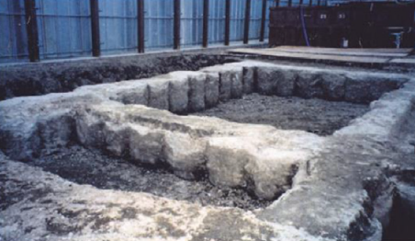
Soils and Foundations 63 (2023) 101352 https://doi.org/10.1016/j.sandf.2023.101352
Dynamic behavior of liquefiable ground reinforced by in-situ cement-mixing lattice wall
Kenji Watanabe, Tengfei Wang, Masahiro Ishikawa, Masatoshi Iijima, Shingo Mihira
[Outline]
In-situ cement-mixing lattice-shaped (lattice wall) against liquefaction
→ Reduce cyclic shear deformation
Critical factor Ratio of the horizontal spacing to the height (L/H).
No experiments of measure τ–γ relationship of liquefied soil within lattice wall.
This study: Evaluate effect of lattice wall through measurement of τ–γ relationship of liquefiable ground inside lattice wall having different L/H ratios.
[Methods]
Shaking table
Shaking table data → FFT filtering and double integration method
[Results]
1. τ–γ of liquefied ground inside lattice wall by 1-g field shaking table tests
2. Two major positive effects:
Delay in the onset of liquefaction by restricting the shear strain
Recovery of shear stiffness of the ground after liquefaction.
3. Effective is based on the L/H

